Slide 1
Digital portfolio
STUDENT NAME | Harish. S
REGISTERATION NO | 20324U09031
NMID | FDB5F3941D94AC1BC3E4D9331D5CE585
DEPARTMENT | BCA
COLLEGE | DR. M. G. R. CHOCKALINGAM ARTS COLLEGE
UNIVERSITY | THIRUVALLUVAR UNIVERSITY

Slide 2
PROJECT TITLE
STUDENT DIGITAL PORTFOLIO USING FRONT END WEB DEVELOPMENT (HTML, CSS & JAVASCRIPT)

Slide 3
AGENDA
Problem Statement
Project Overview
End Users
Tools and Technologies
Portfolio design and Layout
Features and Functionality
Results and Screenshots
Conclusion
Github Link

Slide 4
PROBLEM STATEMENT
The modern digital era, individuals—especially students, job seekers, freelancers, and professionals—require an efficient and impactful way to present their skills, achievements, and experiences online. Traditional resumes and paper-based portfolios are static, lack interactivity, and are often not sufficient to fully showcase a person’s capabilities or creative work. There is a growing need for a digital portfolio system that enables users to create, manage, and share a professional online presence. Without such a system, users face challenges in:

Slide 5
PROJECT OVERVIEW
In today’s competitive and digitally connected world, individuals need more than a traditional resume to effectively present their skills, achievements, and experiences. Static documents like paper resumes or basic CVs fail to showcase creativity, technical abilities, and real-world projects in an engaging and accessible way.
A digital portfolio provides a modern solution by offering a dynamic, interactive platform where users can professionally display their personal information, educational background, skills, projects, and accomplishments. It enables easy sharing, real-time updates, and better visibility in academic, creative, or job-related fields.

Slide 6
WHO ARE THE END USERS?
Students Use the portfolio to showcase academic projects, certifications, assignments, and achievements. Helpful for sharing resumes and CVs during internships or campus placements.
Job Seekers / Fresher's A digital portfolio allows fresh graduates to present their skills, projects, and personal details to recruiters in a more engaging format than traditional resumes

Slide 7
TOOLS AND TECHNIQUES
HTML (Hypertexts Mark-up Language)
CSS (Cascading Style Sheets)
JavaScript
Used to create the basic structure of the web pages. Organized the content into different sections such as:
Home About Me Projects Contact

Slide 8
POTFOLIO DESIGN AND LAYOUT
Sections included:
Home/About Me Projects
Contact Responsive layout (mobile + desktop view).

Slide 9
FEATURES AND FUNCTIONALITY
The digital portfolio includes key features such as an About Me section, education details, skills and achievements, and a project showcase to display personal or academic work. It also has a contact form with basic validation, a responsive navigation menu, and is fully mobile-friendly. Interactive elements like smooth scrolling and animations enhance the user experience. The portfolio is hosted online via GitHub Pages, making it easy to share and access anytime.

Slide 10
RESULTS
A fully functional and responsive digital portfolio website was successfully developed.
Key sections like About Me, Education, Skills, Projects, and Contact were effectively implemented.
JavaScript features such as form validation and smooth navigation enhanced user interaction.
The portfolio was hosted on GitHub Pages, making it publicly accessible online.
The project improved my practical skills in HTML, CSS, JavaScript, and website deployment.

Slide 11
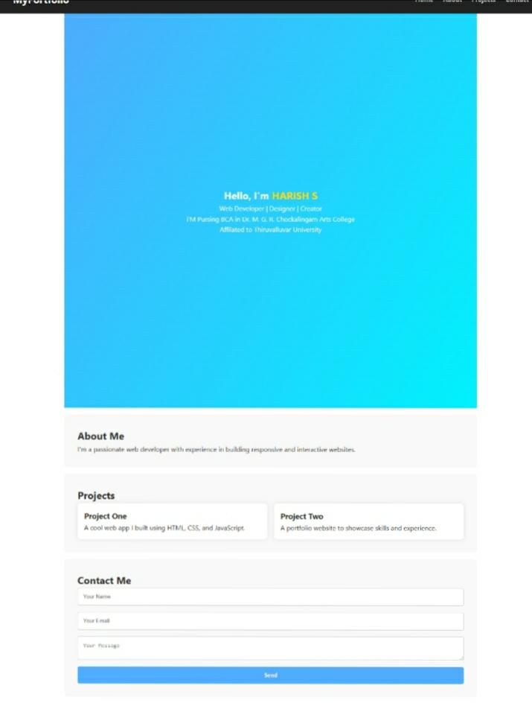
SCREENSHOT/ OUTPUT

Slide 12
CONCLUSION
Summarized my key skills, projects, and accomplishments. Reflected my growth, creativity, and commitment to continuous improvement. Ready to take on new challenges and explore future opportunities.

Slide 13
GITHIB PROJECT LINK
https://github.com/Harish-01-S/Digital-Portfolio.git
PROJECT OUTPUT LINK
https://harish-01-s.github.io/Digital-Portfolio/

